Slide 1
POLS 207 State & Local Government*
Chapter 11C
Adjudicating the Law: Policy and the Courts (Part 3)
Dr. Roblyer, Ph.D.
*These slides are based on originals provided by Dr. Harvey Tucker

Slide 2
Learning Objectives
Based on the “Red, White, and Blue” video, explain the rationales provided for appointing or electing judges/justices.
Based on the Democracy Now! video, describe how campaigns have changed in state judicial races and how and why this may threaten the fairness of the courts.
Based on the article by former-Chief-Justice Cobb, discuss the role of campaign donations in a state with elected judges/justices, their effect on the judiciary, and the expectations of donors.
Describe the two examples she provided about judicial conduct in Texas that was unethical, but legal.
Describe the distribution of executions in the US since 1977. Characterize the frequency of executions in Texas since 1996.
Discuss Judge Price’s dissent in the Panetti appeal, including his rationale and the reasons it could be thought-provoking.
Explain the reasons that capital punishment is losing US public support.

Slide 3
Learning Objectives
Discuss the disagreement between the conservative researcher and the National Research Council report on whether the death penalty has a measurable deterrence effect.
Describe the problems posed for the death penalty by the timeline, expense, and errors in these capital cases.
Use the example of the capital crime in Van Zandt County to illustrate those problems.
Discuss the frequency and reasons for exonerations. Discuss the role of DNA and non-DNA factors in the three cases of Texans previously imprisoned for crimes they did not commit.
Characterize the exonerations US-wide in capital cases since 1973.
Discuss the recent spikes in exonerations in Texas. Also list the number of death-row exonerations within the state.
Highlight why the judiciary should matter to state residents.

Slide 4
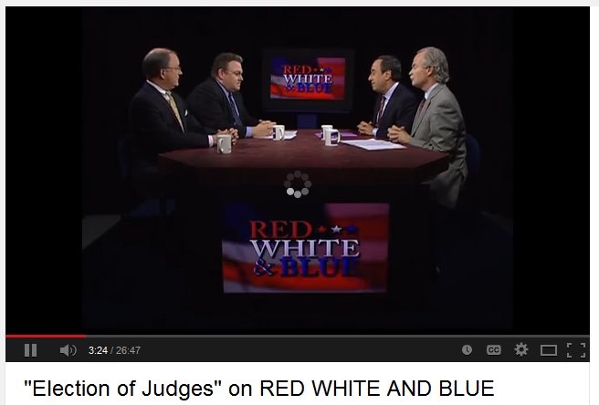
Realities of TX Judicial Elections?
Discussion from both Democratic and Republican perspectives
https://youtu.be/W32lXNhGST4 (first 11 mins of 26:47)
Notes:
http://youtu.be/p4ATqeNEtLw

Slide 5
Elect or Appoint the Judiciary?
Reasons often given for appointing judges and justices
Judiciary is more “independent” – protected from biasing decisions toward key past or future campaign donors
Voters don’t know who judiciary candidates are, even when they vote for them
Reasons often given for electing judges and justices
Why shouldn’t the people choose?
More likely to have judiciary that reflects the demography of their jurisdictions
Appointed judges may not have campaign donors to please, but they do have political obligations to whomever appointed them, or lobbied for their appointment—politics will always be a consideration
Every rationale above has flaws and contradictions, but political scientists have found no clear, consistent distinctions between decisions made by elected judiciary and those made by appointed judges and justices

Slide 6
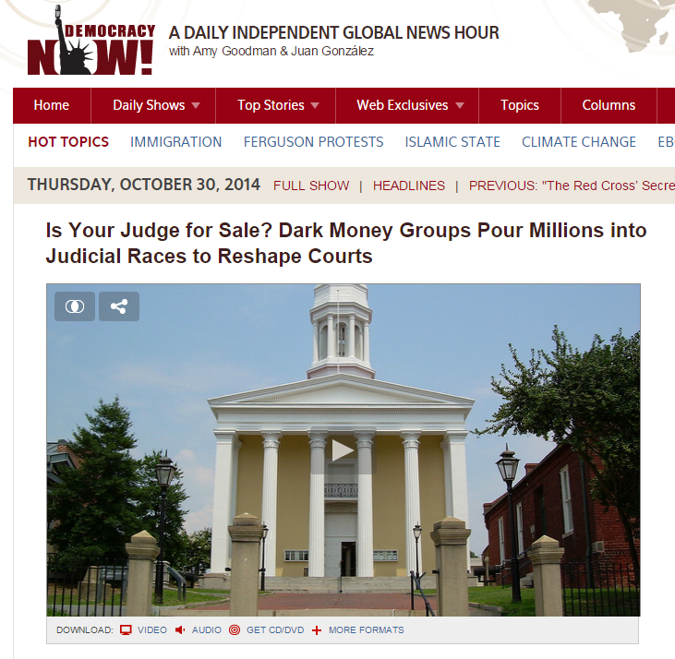
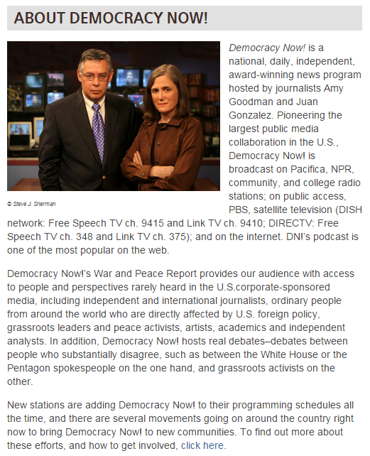
Elect or Appoint the Judiciary?
Question may be fundamentally changing with big campaign $$$
Recent US Supreme Court campaign financing decisions are rapidly and dramatically increasing donations in state/local judicial elections
Effects on judicial ethics and decisions are TBD
Government ethics watchdogs are highly concerned
https://youtu.be/BXg4-g_WbmY
Notes:
http://www.democracynow.org/2014/10/30/is_your_judge_for_sale_dark

Slide 7
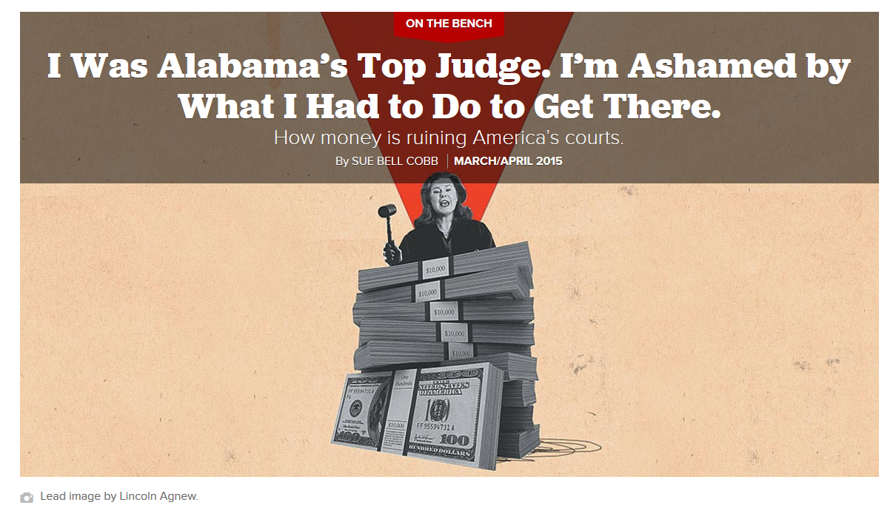
http://www.politico.com/magazine/story/2015/03/judicial-elections-fundraising-115503.html#.VS3lwJPR9SE
“…To get to the justice’s chambers, I had won the nation’s most expensive judicial race that year. But at what cost?”
Elected in 2006, spending $2.6 million to win, even over an opponent who spent $5 million
“…It’s terribly awkward and uncomfortable for a judge to have to ask for campaign money. But how are you going to win without it? My biggest concern is how shameful all of this looks to the public.”
A reporter asked her: “…how can you assure the people of Alabama that the contributions you sought are not going to impact how you rule? And how can you convince [them] not to believe that their courts are for sale?”
“…I never quite got over the feeling of being trapped inside a system whose very structure left me feeling disgusted.”

Slide 8
Judicial Campaigns per Cobb
Standard lines of attack:
“Soft on crime”
“Legislates from the bench”
“Thwarts the will of the people”
“Activist”
Always consider viewpoint & agenda of ad sponsor
Check the facts—false claims are increasingly common
Cobb: “Many ads for judicial candidates I’ve seen are downright terrifying, with would-be judges bashing opponents as if they were evil incarnate. These candidates were portrayed as judges who, if given the chance, would release child molesters and murderers and order them to move in next door. Nothing could be further from the truth. But dignity and fairness are too often the first casualties in these kinds of endeavors. How else to explain a campaign ad from the late 1990s in which one candidate for the Alabama Supreme Court, who was revered by many in the bench and bar, nevertheless gave in to pressure from his campaign consultants and ran an ad comparing his opponent to a skunk? The ad opens with the image of the animal and is replaced by a photograph of the opponent as the narrator explains, ‘Some things you can smell a mile away. … You can smell how bad this man’s ideas are no matter where you live in Alabama.’”
http://www.politico.com/magazine/story/2015/03/judicial-elections-fundraising-115503.html#.VTCBLZPR9SF

Slide 9
Judicial Campaigns per Cobb
Trying to fix the problem from within government didn’t work
Cobb: “I worked for years with former state Representative Jeffrey McLaughlin to eliminate partisan races for judicial office that often make these campaigns overtly and inappropriately political and tend to drive up the amount of money spent by outside groups. And each time—whether the legislature was controlled by Democrats or Republicans—we couldn’t make headway. McLaughlin even recounts how one Republican legislator threatened lawmakers of his own party that if they voted to eliminate partisan judicial races, he would ensure they would face primary opponents in their next campaigns.”
What donors really want…
Cobb: “Here’s the thing: Donors want clarity, certainty even, that the judicial candidates they support view the world as they do and will rule accordingly. To them, the idea of impartial and fair judges is an abstraction. They want to know that the investments they make by donating money to a candidate will yield favorable results. For businesses, this means judges who are skeptical of, or hostile to, malpractice suits and product liability claims. For unions, it translates to backing those who see business, especially Big Business, as the enemy.
Cobb: “They just want to win.”
http://www.politico.com/magazine/story/2015/03/judicial-elections-fundraising-115503.html#.VTCBLZPR9SF

Slide 10
Judicial Solicitation of Funds
In Cobb’s state, Alabama, as well as in Texas, it is legal for the judicial candidates to ask donors directly for funds
Here are 2 instances from Texas she cited:
One judge emailed a small group of partners at a prominent firm to point out contributions made by other firms. “[A]ll the Top 10 firms are committed to maxing out as a firm: $30,000 total,” the judge wrote, requesting that their firm “do the same.” “At most of the firms, they are designating a senior partner … to bundle dozens of relatively small-$ contributions … until they reach the target,” the judge explained, promising, “Bottomless thanks!”
Another judge, soon after winning election, sent a personal email to a local lawyer that stated in part: “I trust that you will see your way clear to contribute to my campaign account in an amount reflective of the $2,000 contribution you made towards my defeat … and the fact that by their very nature post-election contributions are tardy and in very few realms does tardiness not incur an up-charge.”
Her assessment: “These overtures are shameful. They’re embarrassing. And they’re perfectly legal.”

Slide 11
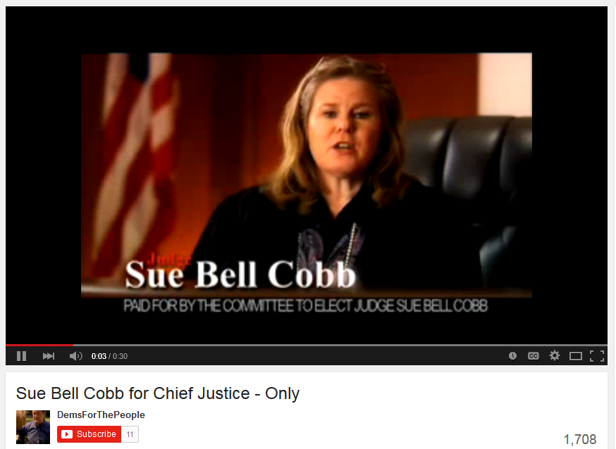
How did she run for the bench?
https://youtu.be/fECwJq4PkI8
Listen to the topics she includes in her 30-sec TV spot
What was her “tough on crime” claim?
Notes:
https://youtu.be/y2guyWS57OA

Slide 12
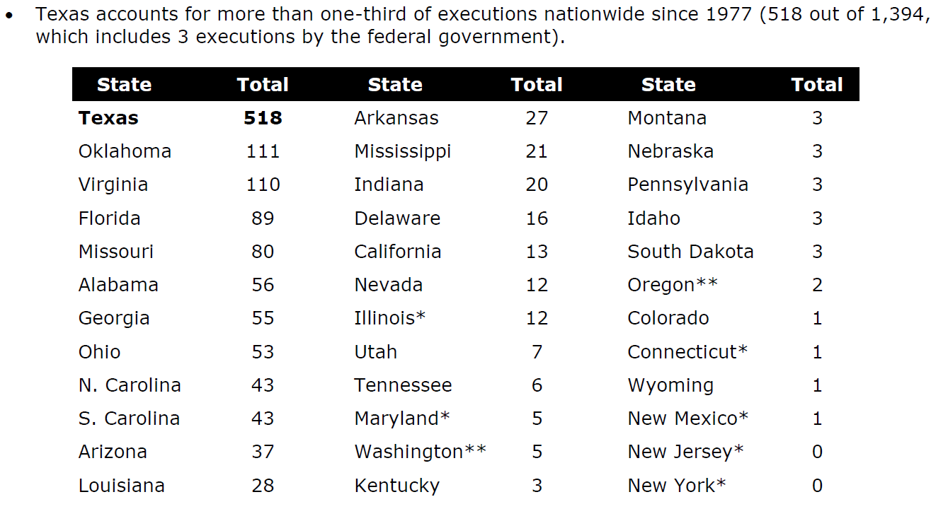
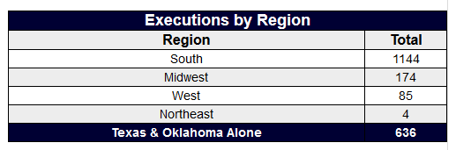
Death Penalty Facts
Support for, and use of, the death penalty is a common “litmus test” of social conservativism
Such support is the ultimate “tough on crime” position, especially in the South and Southwest regions of the U.S.
32 states still have this sentencing option, but only 17 have used it in the last 5 years
http://www.deathpenaltyinfo.org/number-executions-state-and-region-1976
http://tcadp.org/get-informed/texas-death-penalty-facts/

Slide 13
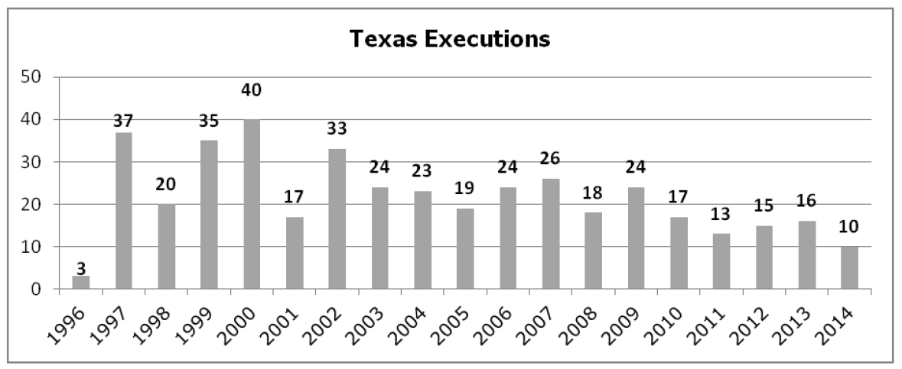
Executions in Texas
2015: 13
2016: 7
2017: 7
Average length of time on Death Row is 9 years
274 inmates currently on Death Row
Third largest population in U.S.
Total population on state Death Rows: ~3000 (2016)

Slide 14
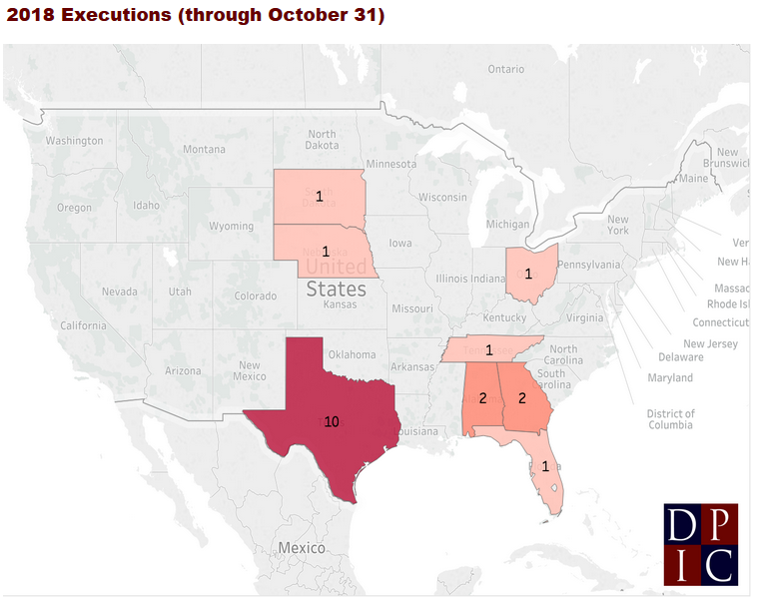
Executions in Texas
2015: 13
2016: 7
2017: 7
Average length of time on Death Row is 9 years
274 inmates currently on Death Row
Third largest population in U.S.
Total population on state Death Rows: ~3000 (2016)
https://deathpenaltyinfo.org/execution-list-2018

Slide 15
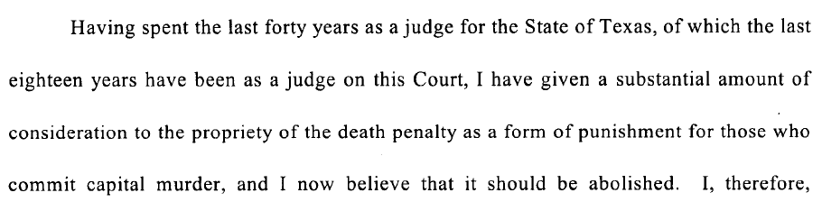
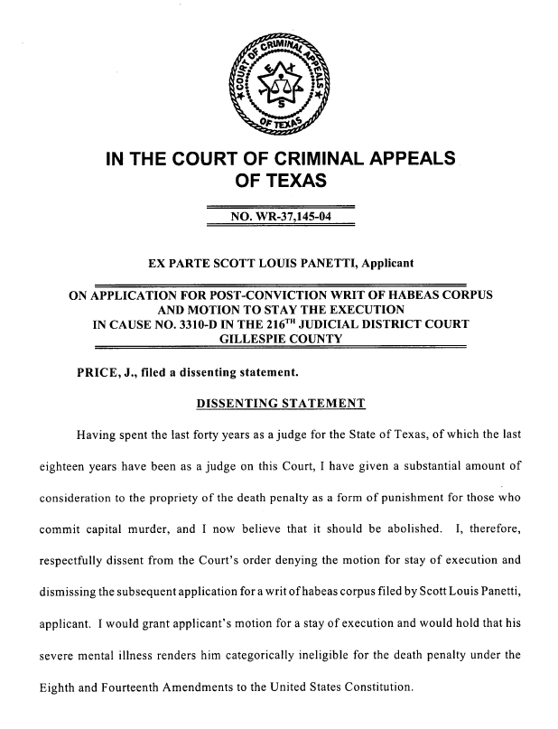
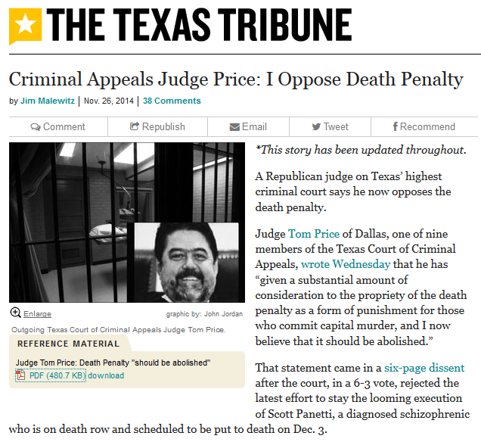
A “Keeper of the Process” Turns Against the Death Penalty
Judge Tom Price, was then an 18-year veteran member of the 9-person Texas Court of Criminal Appeals (term ended in Jan 2015)
http://www.texastribune.org/2014/11/26/criminal-appeals-judge-price-i-oppose-death-penalt/

Slide 16
What is the problem with the death penalty?
Capital punishment losing support of public
Life-without-parole sentencing now available in all 50 states (in Texas since 2005)
Deterrence effect is doubted
No scientific support for deterrence

Slide 17
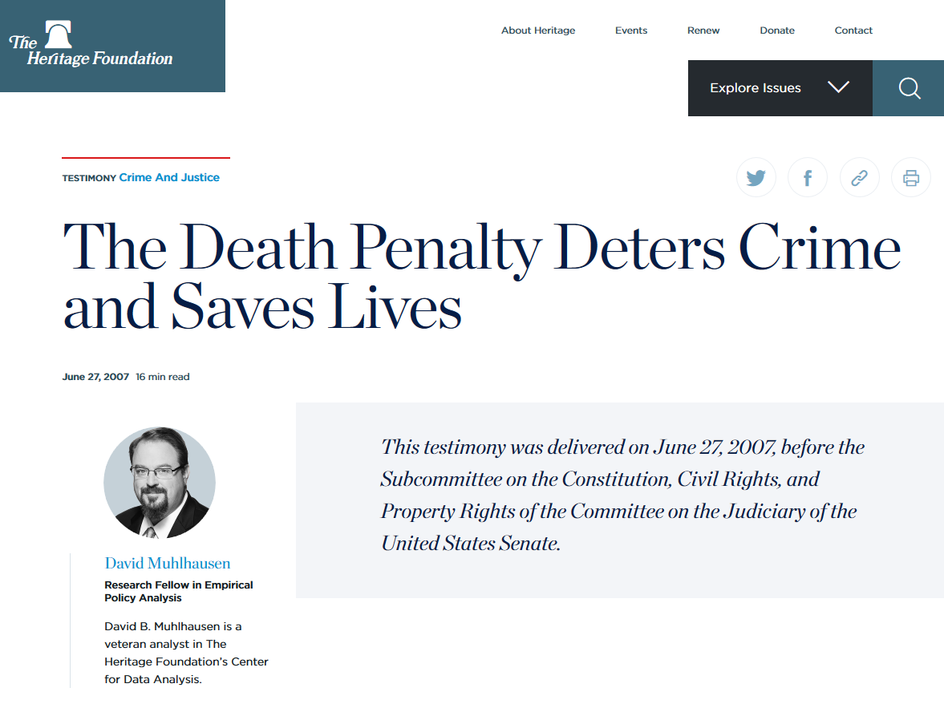
Many conservatives disagree…
https://www.heritage.org/testimony/the-death-penalty-deters-crime-and-saves-lives

Slide 18
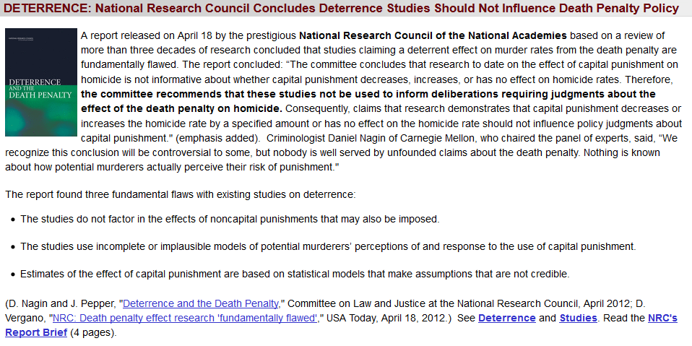
…but the Science Community says there is no demonstrable relationship
https://deathpenaltyinfo.org/deterrence-national-research-council-concludes-deterrence-studies-should-not-influence-death-penalty

Slide 19
What is the problem with the death penalty?
Capital punishment losing support of public
Life-without-parole sentencing now available in all 50 states (in Texas since 2005)
Deterrence effect is doubted
No scientific support for deterrence
Delays (…25 yrs in the case on which Judge Price dissented)
Expense
Multiple studies find death penalty cases to cost millions more than life imprisonment
About 2-4 times more expensive than imprisonment for life
Errors in the form of wrongful convictions
Read more:
https://deathpenaltyinfo.org/policy-issues/costs
https://www.amnestyusa.org/issues/death-penalty/death-penalty-facts/death-penalty-cost/
https://www.thebalance.com/comparing-the-costs-of-death-penalty-vs-life-in-prison-4689874

Slide 20
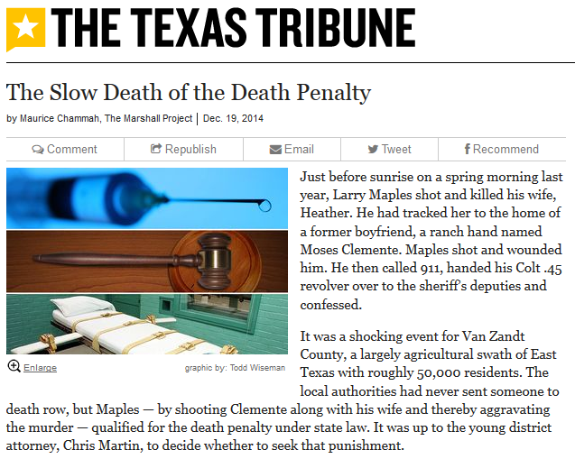
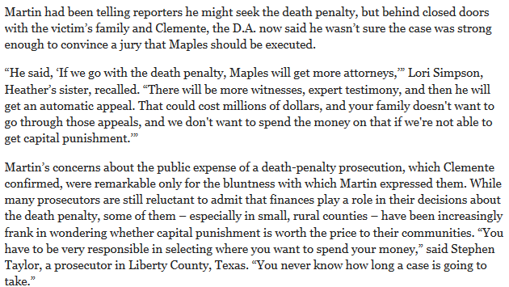
The cost of capital punishment hurts more in smaller Texas counties
http://www.texastribune.org/2014/12/19/slow-death-death-penalty/

Slide 21
The cost of capital punishment hurts more in smaller Texas counties
http://www.texastribune.org/2014/12/19/slow-death-death-penalty/

Slide 22
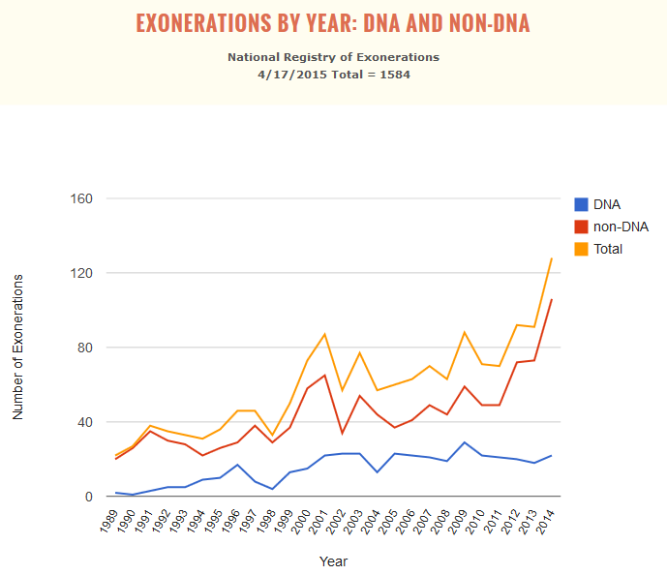
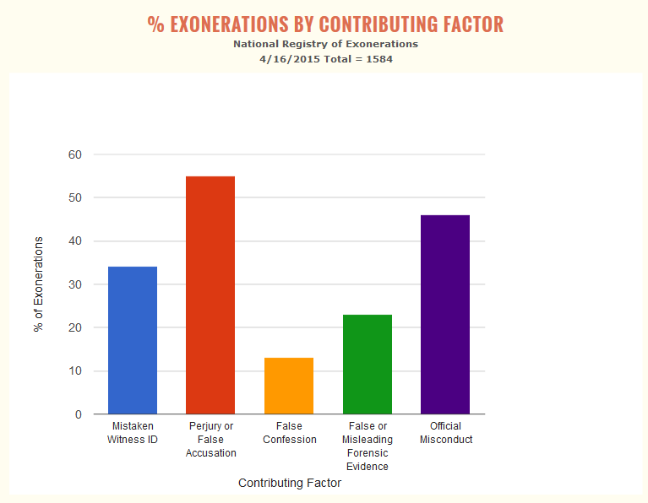
Are we ever wrong? Exonerations set the innocent free…
…for any crime, not just capital ones
National Registry of Exonerations (University of Michigan Law School)

Slide 23
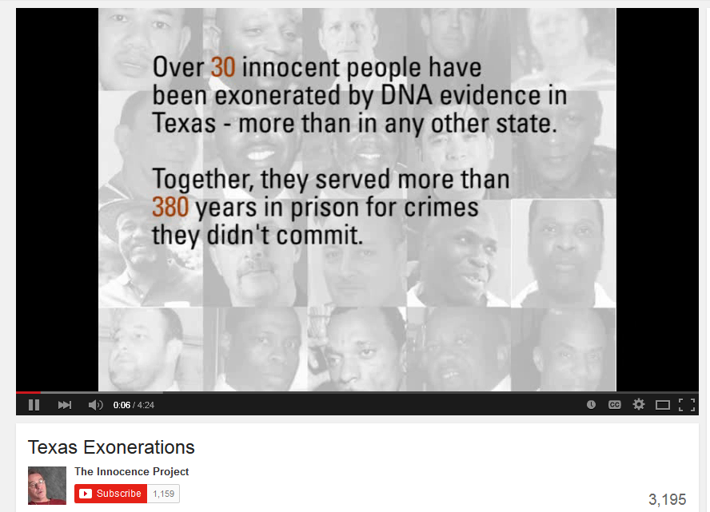
3 Texas Stories
https://youtu.be/6kdPE0ZNxDg
Notes:
https://youtu.be/D6aasfwCC24

Slide 24
Exonerations in Texas
Across the U.S.,150 innocent people have been removed from Death Row since 1973
12 of those were in Texas
In Texas, 54 innocent inmates (all types) were exonerated in 2015
Most of any state, and over 1/3 of national total
2014: 40 exonerations

Slide 25
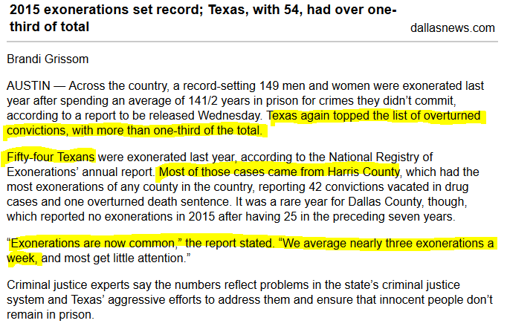
Exonerations in Texas
Across the U.S.,150 innocent people have been removed from Death Row since 1973
12 of those were in Texas
In Texas, 54 innocent inmates (all types) were exonerated in 2015
Most of any state, and over 1/3 of national total
2014: 40 exonerations
https://www.dallasnews.com/news/crime/2016/02/02/2015-exonerations-set-record-texas-with-54-had-over-one-third-of-total

Slide 26
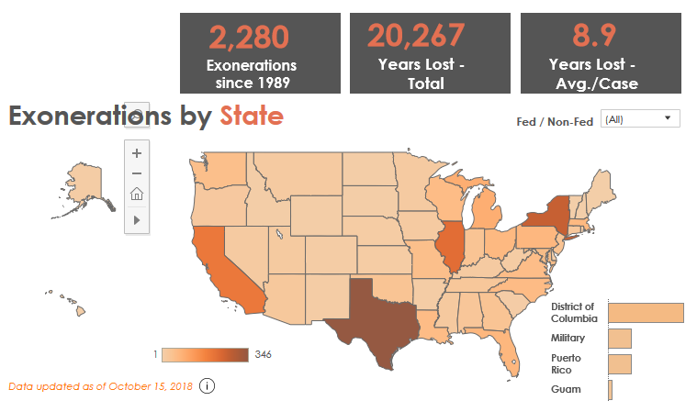
Exonerations in Texas
Across the U.S.,150 innocent people have been removed from Death Row since 1973
12 of those were in Texas
In Texas, 54 innocent inmates (all types) were exonerated in 2015
Most of any state, and over 1/3 of national total
2014: 40 exonerations
https://www.law.umich.edu/special/exoneration/Pages/Exonerations-in-the-United-States-Map.aspx

Slide 27
Exonerations in Texas
No currently irrefutable cases of execution of an innocent person in the past
Anti-death-penalty activists point to 3 strongly suspected cases in Texas

Slide 28
WHY the Judiciary Matters
Corporate and special interest big-spenders think it does, and increasingly so
Effects of that money is questionable
But is money neutral, OR is money an expression of power?
Will you vote in the judicial elections?
Will the candidates be unknown names on the ballot?
Will you simply pick the Republican or Democrat?
Will you attempt to assess the records of fairness?
Will you or a loved one commit a crime or go to court on a civil matter?
If a criminal matter, will you be wrongfully convicted? (As an elite, the odds say “no,” but what about someone else?)
If politics is all about winning and losing, the calls of the “referees” (judges & justices) often determine the outcome!

Slide 29
Practice Problems …to begin mastering this material. Complete instructions are in the Module 1 resource, How to Use Practice Problems to Prepare for Exams.
Don’t forget to do the…

